Slide 1
Inventory_report_dashboard

Slide 2
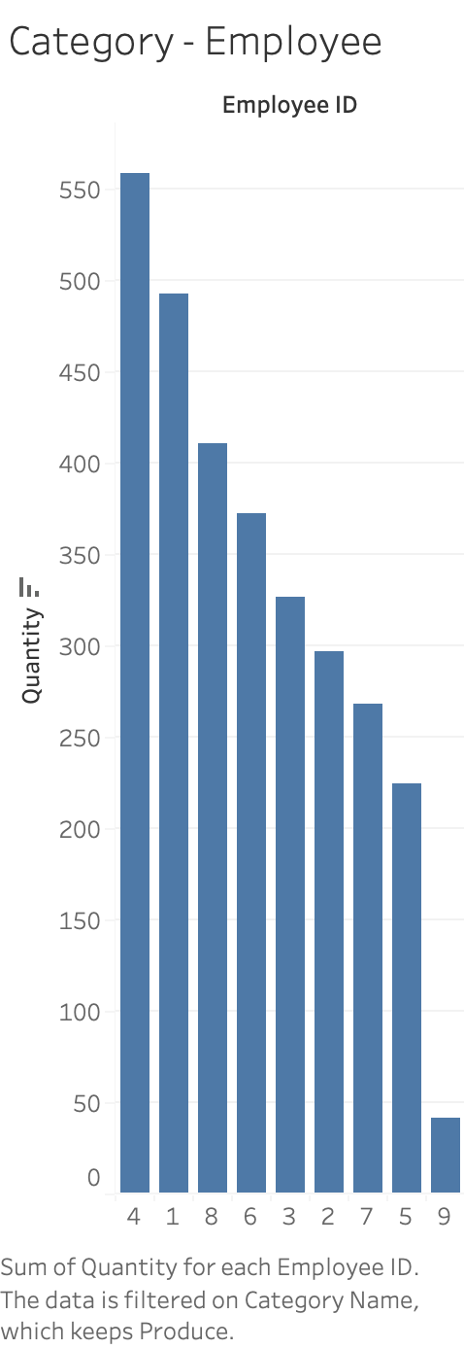

Slide 3
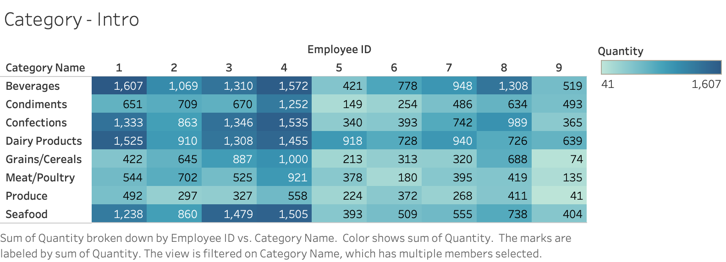

Slide 4


Slide 5
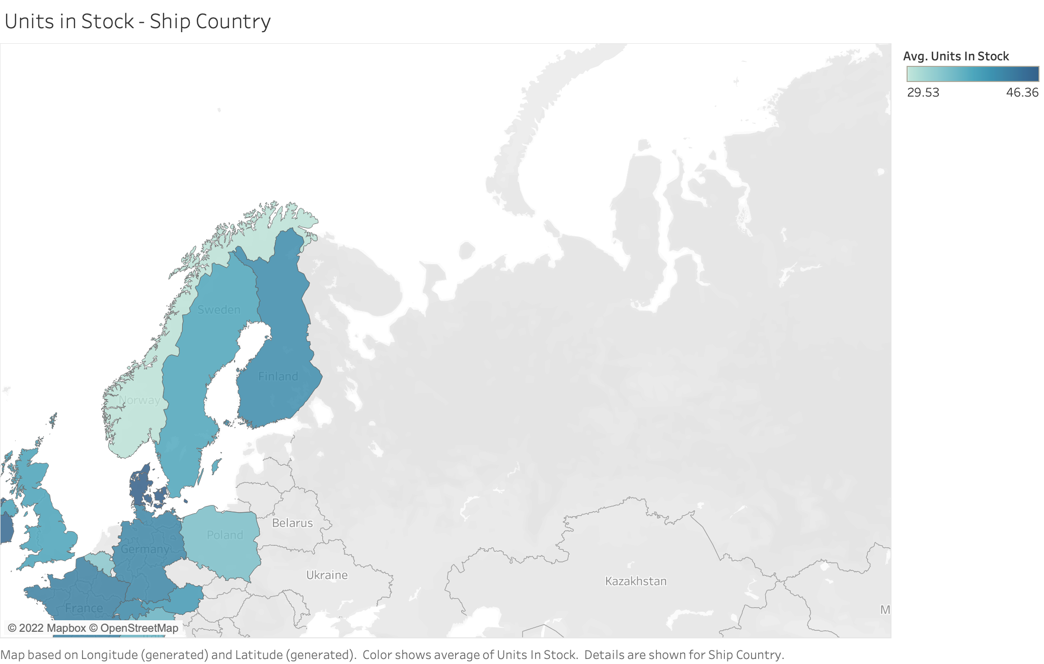

Slide 6
